Slide 2
Practice makes perfect! better!
Practice makes perfect!

Slide 3
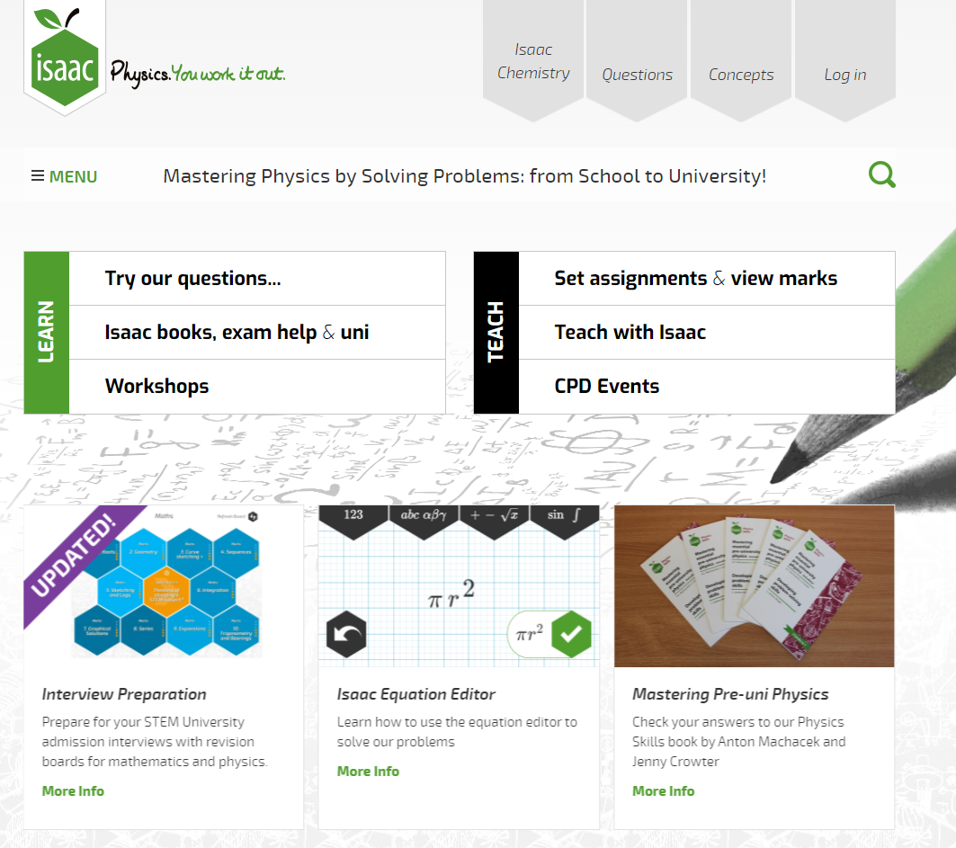
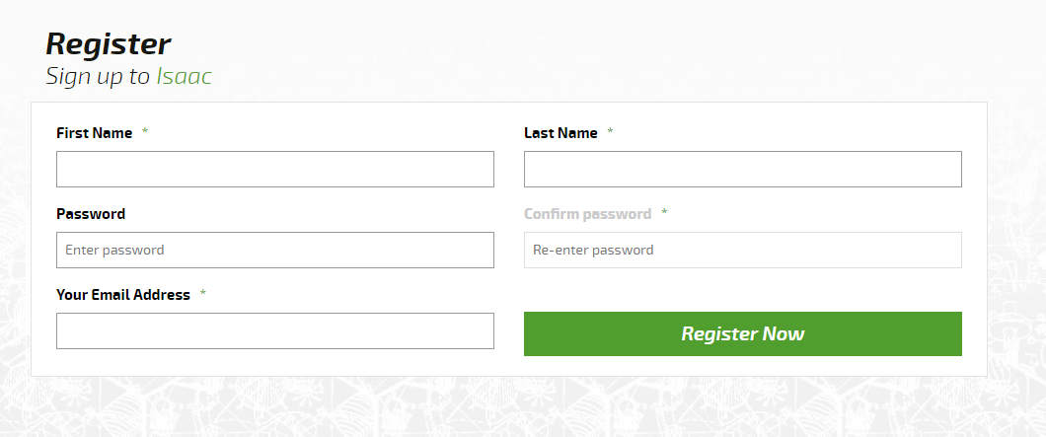

Slide 4
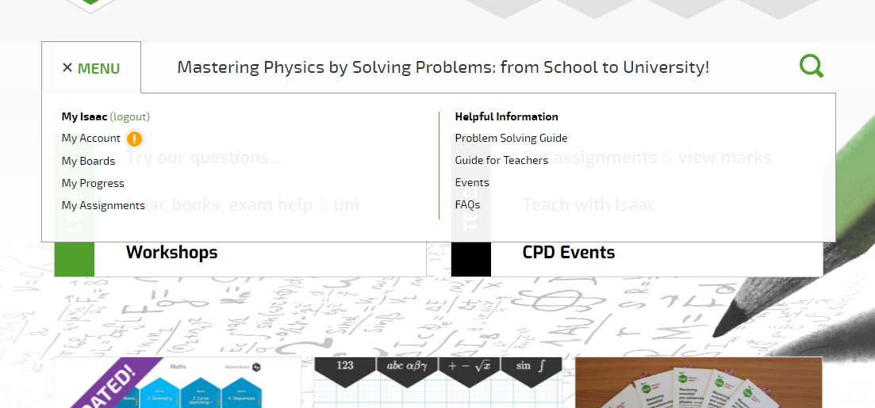
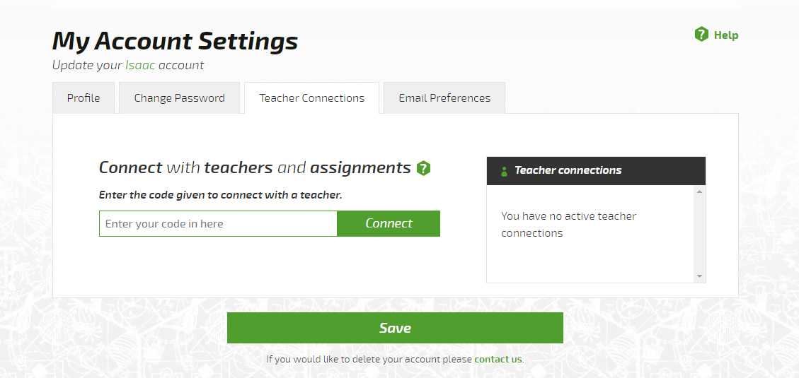
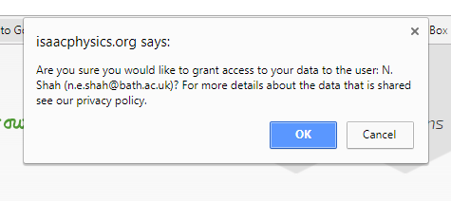

Slide 5
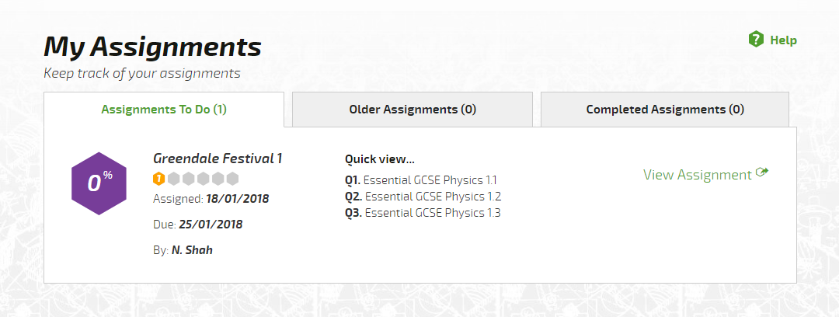
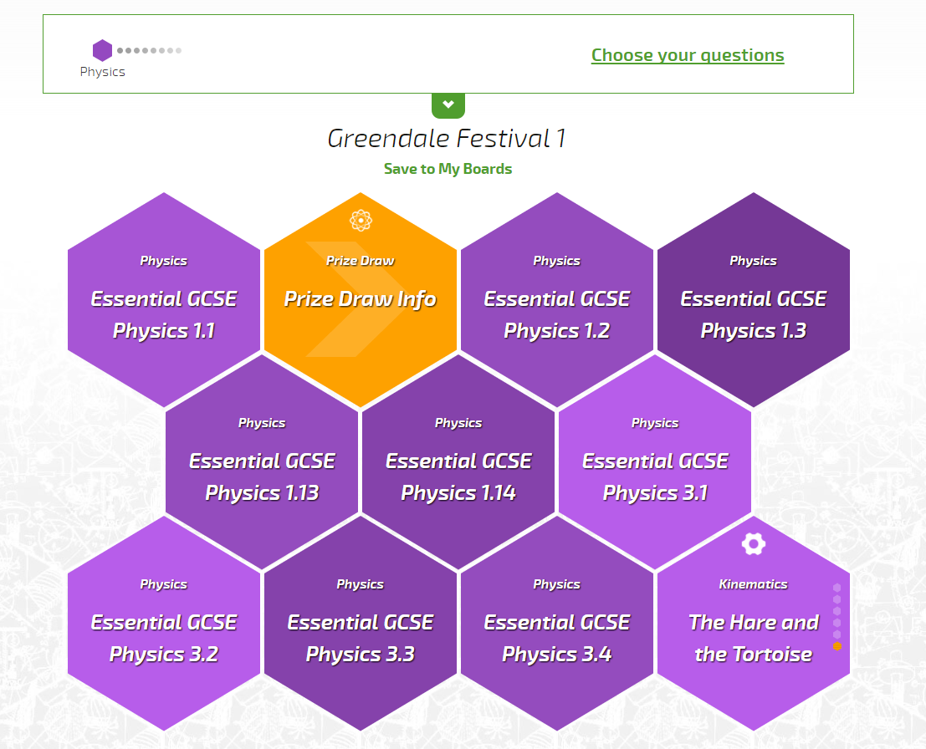

Slide 6
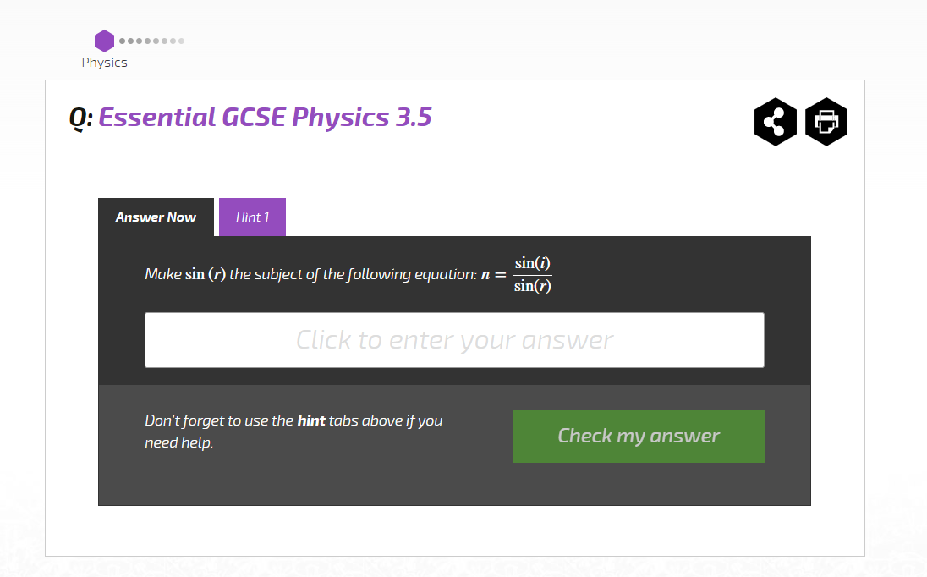
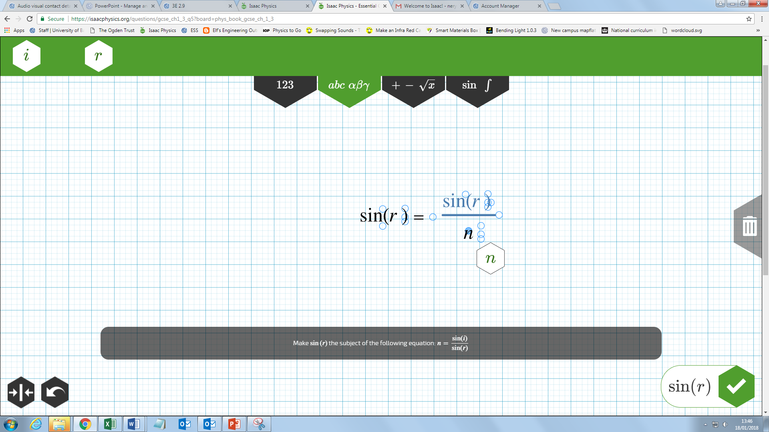

Slide 7
You work for a company that organises outdoor events.
Greendale Council wants to set up a new music festival.
Your company is preparing a bid to win the contract to set up the main stage at the event.
You will present your bid to the ‘council’.

Slide 8
What things are involved in a music festival?
What jobs do people do to support the festival?

Slide 10
1 Creative Spatially aware Using diagrams | 2 Analytical Using diagrams Numerical | 3 Spatially aware Analytical Numerical
4 Attention to detail Advising others Assessing risk | 5 Organisation Leadership Planning | 6 Creative Analytical Visual

Slide 11
1 Construction manager | 2 Electrical engineer | 3 Sound engineer
4 Health and safety advisor | 5 Project manager | 6 Lighting engineer

Slide 12
Between sessions:
Sign up to Isaac Physics
Have a go at the first Isaac Physics assignment
Watch the electrical engineer video
Any problems? Email: outreach@bath.ac.uk

Slide 13
Session 2

Slide 14
Discussion question:
What are the advantages and disadvantages of renewable vs. non-renewable energy sources?

Slide 15
What is an electrical engineer? What do they do at a music festival?

Slide 16
 | Symbol | Units | Description
Current
Voltage
Resistance
Power
amperes (A)
Flow of electric charge
V = IR
I
Difference in electrical potential between two points
V
volts (V)
P = IV
R
ohms (Ω)
Hindrance to the flow of charge
P
watts (W)
Energy transferred per unit time

Slide 17
Symbol | Component | Symbol | Component
Cell
A
Ammeter
Lamp
V
Voltmeter
M
Motor
Speaker

Slide 18
A
V

Slide 19
Between sessions:
Have a go at the next Isaac Physics assignment
Watch the sound engineer video
Watch the lighting engineer video
Any problems? Email: outreach@bath.ac.uk

Slide 20
Session 3

Slide 21
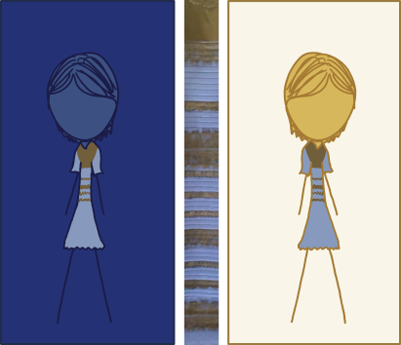
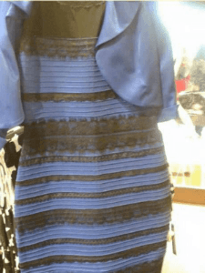
Discussion question:
What colour is the dress?

Slide 22
What is a sound engineer? What do they do at a music festival?

Slide 23
What is a lighting engineer? What do they do at a music festival?

Slide 24
 | Symbol | Units | Light wave | Sound wave
Frequency
Wavelength
Speed
Amplitude
f
hertz (Hz)
Colour
Pitch
λ
metres (m)

Slide 25
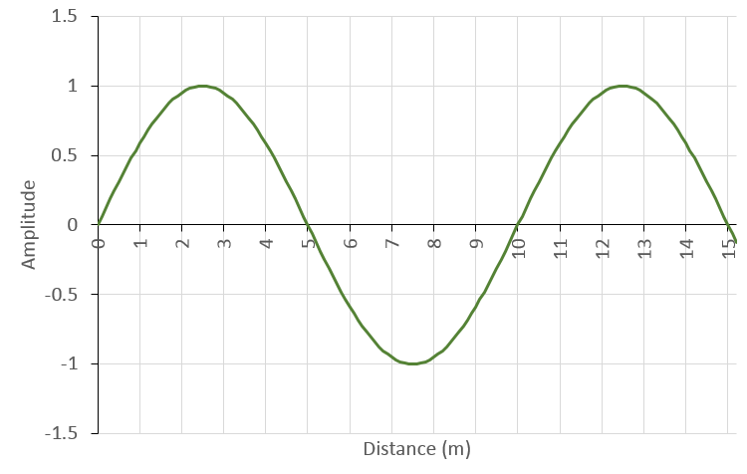
λ

Slide 26
 | Symbol | Units | Light wave | Sound wave
Frequency
Wavelength
Speed
Amplitude
f
hertz (Hz)
Colour
Pitch
v = f λ
λ
metres (m)
Colour
Pitch
v or c
metres per second (ms⁻¹)
3.00 x 10⁸ ms⁻¹ (in a vacuum)
343 ms⁻¹ (in air)
A
Intensity
Volume

Slide 27
λ
A

Slide 28
Sound level | Example
0dB | Threshold of human hearing
10dB | Breathing
20dB | Rustling leaves
30dB | Whispering
40dB | Quiet library
50dB | Rain
60dB | Normal conversation (from 1m distance)
70dB | Vacuum cleaner
80dB | Alarm clock
90db | Lawn mower
100dB | Motorcycle
110dB | Screaming baby
120dB | Thunderclap
130dB | Threshold of pain

Slide 29
Between sessions:
Have a go at the next Isaac Physics assignment
Watch the construction engineer video
Any problems? Email: outreach@bath.ac.uk

Slide 30
Session 4

Slide 31
What is a construction engineer? What do they do at a music festival?

Slide 32
Mass and Weight
Mass – how much ‘stuff’ something is made of, measured in kilograms (kg)
Weight – force that gravitation exerts on an object, measured in newtons (N)
weight = mass x gravitational field strength
F = mg
On Earth, g = 9.81ms⁻²

Slide 33
Force diagrams
Reaction force of surface
= -mg
Weight of block
= mg

Slide 34
Reaction force
Compression
Reaction force
Compression
Tension
Tension
Weight of block

Slide 35
Reaction force
Reaction force
Weight of block

Slide 36
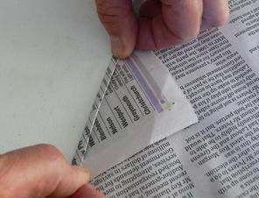
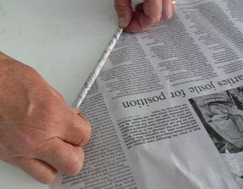
Fold over one corner
Turn over the smallest fold you can
Continue to fold/roll the paper as tightly as possible

Slide 37
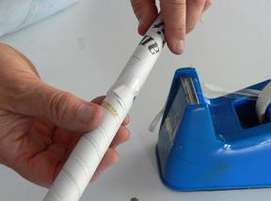
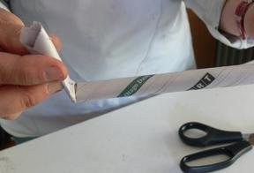
Tape down the corner
Cut off weaker ends

Slide 38
Between sessions:
Have a go at the next Isaac Physics assignment
Any problems? Email Nerys at: outreach@bath.ac.uk

Slide 39
Session 5

Slide 40
 | Symbol | Units | Description
Current
Voltage
Resistance
Power
amperes (A)
Flow of electric charge
V = IR
I
Difference in electrical potential between two points
V
volts (V)
P = IV
R
ohms (Ω)
Hindrance to the flow of charge
P
watts (W)
Energy transferred per unit time

Slide 41
 | Symbol | Units | Light wave | Sound wave
Frequency
Wavelength
Speed
Amplitude
f
hertz (Hz)
Colour
Pitch
v = f λ
λ
metres (m)
Colour
Pitch
v or c
metres per second (ms⁻¹)
3.00 x 10⁸ ms⁻¹ (in a vacuum)
343 ms⁻¹ (in air)
A
Intensity
Volume

Slide 42
Mass and Weight
Mass – how much ‘stuff’ something is made of, measured in kilograms (kg)
Reaction force of surface
= -mg
Weight – force that gravitation exerts on an object, measured in newtons (N)
weight = mass x gravitational field strength
Weight of block
= mg
F = mg
On Earth, g = 9.81ms⁻²

Slide 43
Your proposal to the council
List of equipment and total cost
Ticket prices
Your profit
Suggested bands
Statement on environmental impact
Suggested logo
Map of locations of stage(s) and equipment

Slide 44
Determining your budget/profit
Festival runs over three days – will you have tickets for individual days, all three days or a mixture?
Maximum of 15,000 people – but likely to be fewer if ticket prices are too high
Income = ticket price x number sold
Profit = income - expenditure
£££

Slide 45
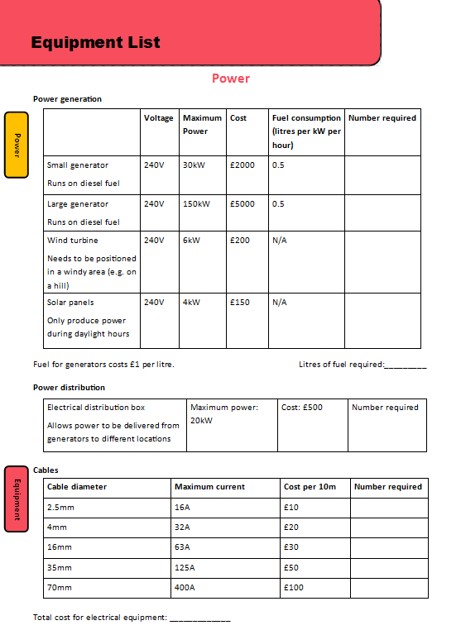
Total power needed by your equipment?
Environmental impact of power generation?
Does power need to be distributed around the site?
What current will be running through your cables?
What H&S issues do you need to consider?
How much fuel will you need?

Slide 46
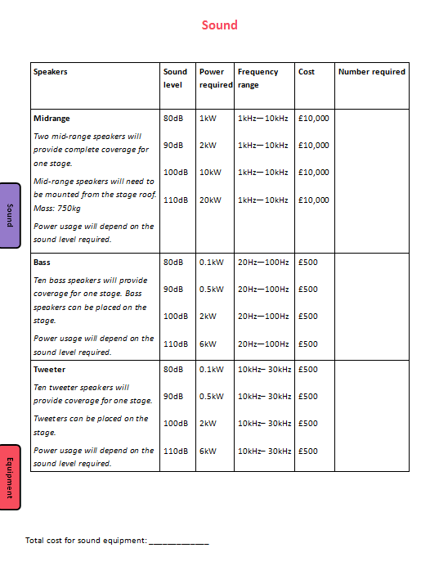
What sort of music will be playing?
What range of frequencies need to be played?
What sound level will you have?
Will you need to suspend speakers from the stage roof?
How much power will you need?

Slide 47
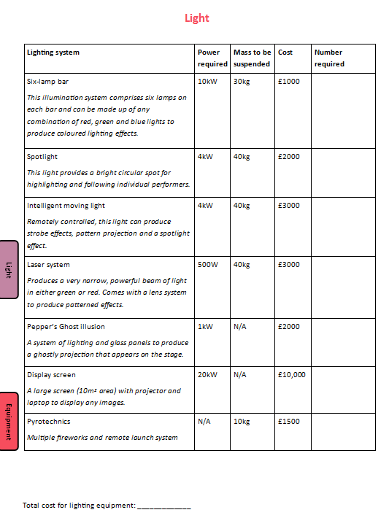
This is a chance to be creative!
What lighting effects will suit the music?
Will different bands want different effects?
Will you need to suspend lighting from the stage roof?
How much power will you need?

Slide 48
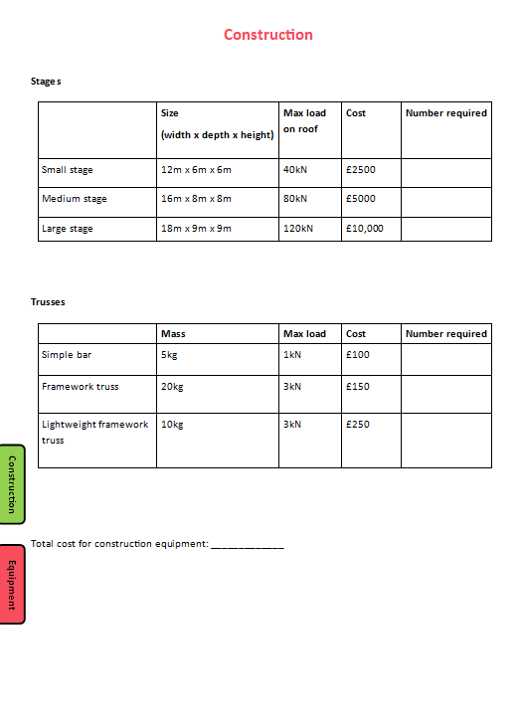
How many stages will you have?
Where will they go?
How much mass do you need to suspend from the roof?
How many trusses will you need to support your equipment?

Slide 49
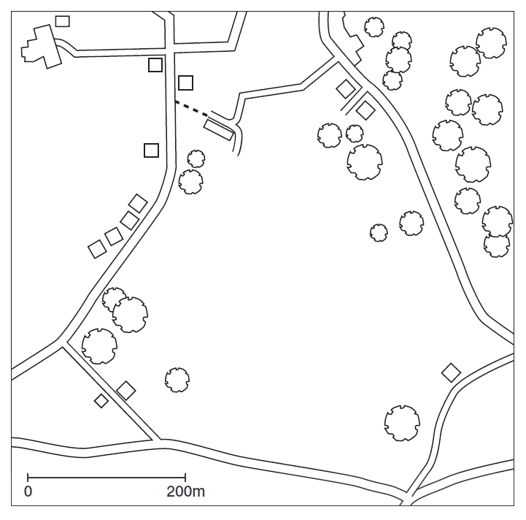
N
Remember:
The festival site is on a hillside, sloping from the north-west to a peak in the south-east.
All roads will need to remain open during the festival.

Slide 50
Between sessions:
Have a go at the next Isaac Physics assignment
Continue to choose equipment and put together your proposal
Any problems? Email Nerys at: outreach@bath.ac.uk

