Slide 1
Outreach Opportunities for your students

Slide 2
Lots of different opportunities…
Webinars
E-Mentoring
Online/Blended Programmes
Open Days & Events
Summer Schools
School Visits

Slide 3
Why get involved in outreach…
Guaranteed offer
Enriched learning & skills
Experience student life
Make friends and try new things
Additional help & support

Slide 4
Eligibility Criteria
Postcode Measures:
IMD Q1/2 Postcode?
FSM?
Self Declared:
Care Experienced/Care Leaver
Refugee/Asylum-seeking
Young Adult Carer
Estranged

Slide 5
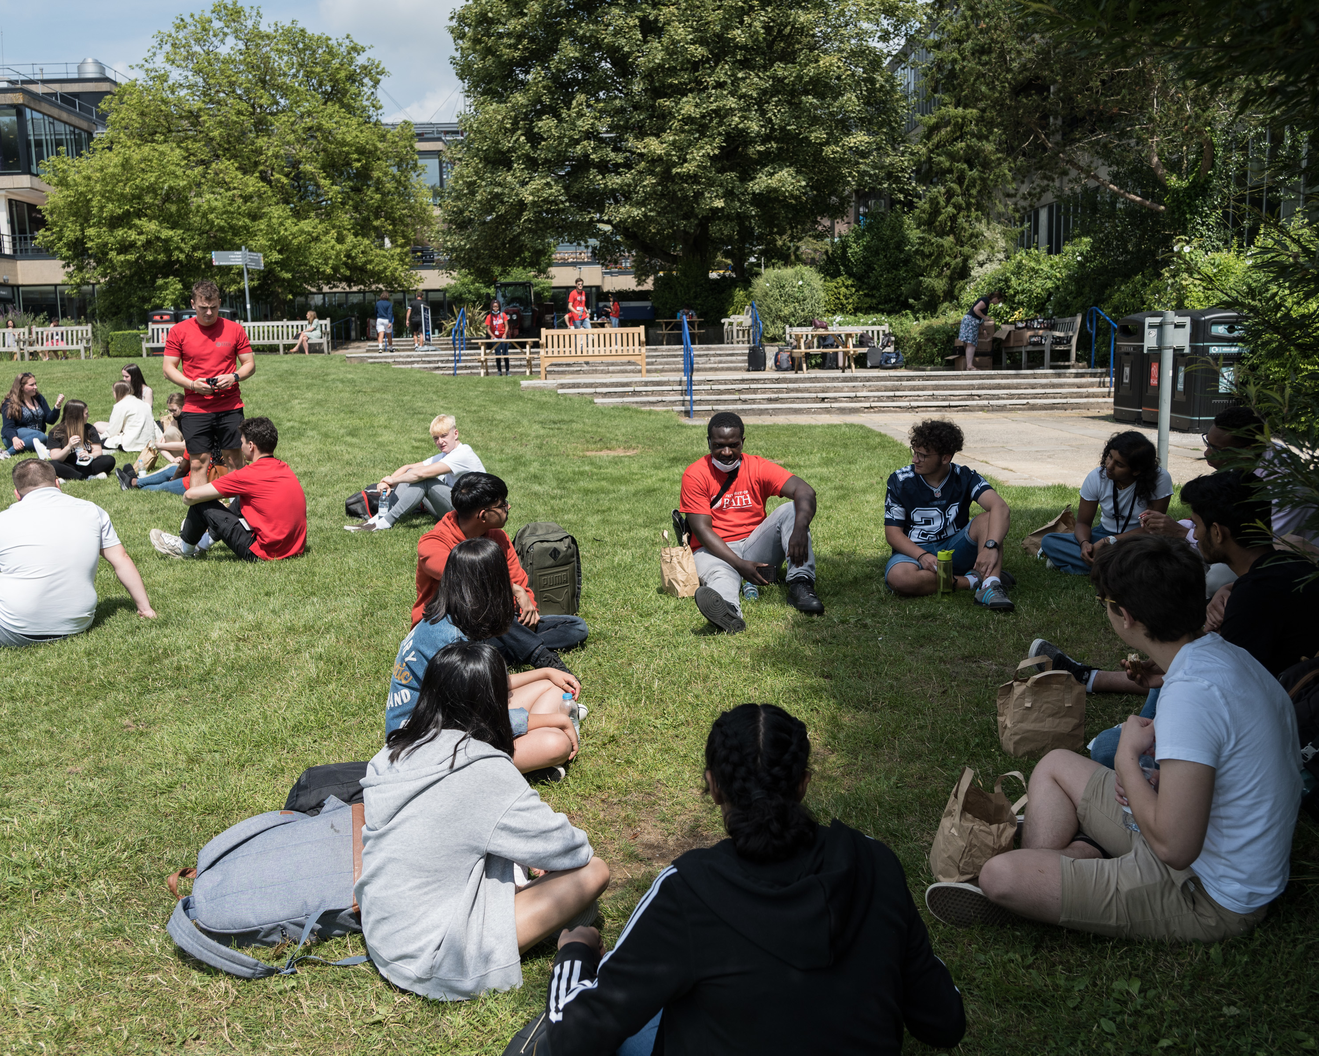
Pathway to Bath Year 12
Award winning blended learning programme
Between February and July
Project research
Free residential
Guaranteed Offer
Guaranteed place on Apply with Bath

Slide 6
Blended Pathway to Bath Y12
Online Teaching Feb-June
Independent Project
Uni Life Sessions
3-day Residential
Alternative Offer
Guaranteed place on Apply with Bath

Slide 7
Discover Bath Year 12
Summer school - 4 Days
Taster lectures and seminars
Social and sports activities
Independent work
Guaranteed Offer
Guaranteed place on Apply with Bath

Slide 8
Apply with Bath Year 13
Self-directed online programme
MS Teams Community
Student E-Mentors
Bookable Personal Statement 1:1
Live Webinars
Employability & Placement Info

Slide 9
Ask Bath E-mentoring Year 10-13
Instant messaging online via a secure platform
Available all year round for Y10 – 13 pupils
Choose an E-mentor in your chosen subject area
Academic peer support
Info about applications
Insights into university life

Slide 10
When to apply
All Year - Ask Bath and Speak to a Student E-Mentoring
May – Apply with Bath Enrollment Open
October – Pathway to Bath Applications Open
December – Discover Bath Applications Open
January – Students invited to Access to Bath

Slide 11
Where can students find the right information?
All universities have different outreach offerings
Universities may have different eligibility criteria– there is no sector wide criteria
Students will need to search the webpage of universities to find outreach
Sometimes this is found on ‘admissions’ pages or on subject pages
Coming soon: UCAS Outreach Connection Service
Top tip: search ‘outreach’ into a university webpage

