Slide 1
Content for Plasma Screens - DSA For Use Academic Year 2023/24
Kevin McMullan
Funding Information Services
Student Loans Company

Slide 2
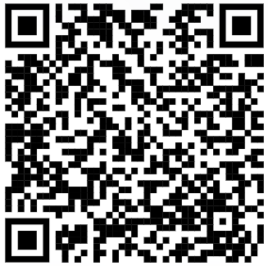
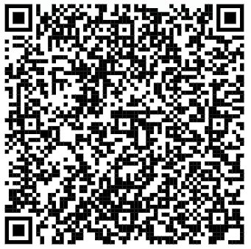
WANT TO KNOW MORE ABOUT DISABLED STUDENTS ALLOWANCE?
Find out about Disabled Students Allowance: Student Finance England
Find out about Disabled Students Allowance:
Student Finance Wales

Slide 3
APPLY
Apply online at the same time you apply for core support. If applying later, you will need to apply using paper application
4. NEEDS ASSESSMENT
It can take 22 days to attend a Needs Assessment appointment so get it booked asap!
2. MEDICAL EVIDENCE
Supply your Medical Evidence in one of these three formats:,
Diagnostic Report (learning difficulties)
Letter from a GP or other Medical Professional
SFE Disability Evidence Form
5. DSA2 LETTER
This letter confirms your package of support and instructions for ordering specialist equipment / arranging other support
6. PAYMENT
Suppliers invoice DSA Team directly for the support they have provided (students are liable for a £200 contribution of any laptop/PC recommendations).
Some students are also agreed a General Allowance and are able to send receipts (student claims) to claim back these costs
3. DSA1 LETTER
SLC will send you a DSA1 letter, confirming your eligibility for DSA and instructions for booking your NEEDS ASSESSMENT

Slide 4
DSA is a grant so doesn’t need to be repaid!
LEARNING DIFFICULTIES
BLIND / PARTIAL SIGHT
ELIGIBLE FOR DSA
AUTISM
DEAF / PARTIAL HEARING
LONG STANDING ILLNESS
WHEELCHAIR / MOBILITY
MENTAL HEALTH
MULTIPLE DISABILITIES
OTHER DISABILITY
Up to £26,291 per year available to SFE students eligible for DSA.
SCAN FOR FULL DETAILS

