Slide 1
Stand out from the crowd with an EPQ
Rebecca Crumpton
Head of Curriculum - Business, Economics and Projects
Notes:
Good morning
Thank you for joining me for this session on our EPQ.
I am conscious that there will be differing knowledge and experience of EPQ in the room today and I have therefore tried to structure this session to be appropriate for all.
Today I will be covering:
What is an EPQ?
Benefits of Projects qualifications
Tips for a successful EPQ programme
How Project Q can help you to deliver the qualification
Q&A
For those of you already delivering our EPQ, I hope some of this session serves as a refresher and for those brand new or considering offering our EPQ, I will be briefly introducing you to the qualification and how to successful set this up in you school or college. I will also touch upon the level 1 and 2 projects qualifications.

Slide 2
What is an EPQ?

Slide 3
The philosophy of Project Qualifications
Project Qualifications allow learners to follow their passions and stand out from the crowd
Learners will independently plan and carry out research on a topic that they've chosen and isn't covered by their other qualifications.
They can take inspiration from something touched on in class or something personal and unrelated to their studies. They then use this research to produce an academic written report or, in the case of practical projects, an artefact or a production with accompanying report.
By taking responsibility for the choice, design and decision making of an individual project (or an individual role in a group project) students learn key academic skills, including:
becoming more critical, reflective and independent learners
developing and applying decision-making and problem-solving skills
building their planning, research, analysis, synthesis, evaluation and presentation skills
applying technologies confidently
demonstrating creativity, initiative and enterprise.
Notes:
Not only do projects qualifications support development of research skills, by their unique design, they support students in learning more about what matters to them in the world around them.
The freedom of choice provided by projects allows learners to explore their individual passions or interests outside of their usual studies – this opportunity to study a wider curriculum broadens students’ surroundings
Rather than following the content on a specification, the qualification encourages different thinking, autonomy and resilience in learning, which in turn builds confidence and aids at key transitions points in preparing learners for the next stage in education and life.
A really valuable part of EPQ is putting the learning in the hands of the students.
For some young people, it will be the first time in their school life, someone has said to them "Well what are you going to do? What do you think about that?" And that can be really powerful for young people in that quite tightly controlled GCSE or A-level environment- to have a little bit of space, to make their own decisions about their own learning, and what they want to find out

Slide 4
Foundation, Higher and Extended Projects
Foundation | Higher | Extended
Level 1 | Level 2 | Level 3
60 GLH | 60 GLH | 120 GLH
30 hours taught skills | 30 hours taught skills | 30 hours taught skills
30 hours independent work | 30 hours independent work | 90 hours independent work
1,000 word written report or artefact with minimum 250 word report | 2,000 word written report or artefact with minimum 500 word report | 5,000 word written report or artefact with minimum 1,000 word report
Worth half a foundation level GCSE graded A* to B | Worth half a higher level GCSE graded A* to C | Worth half an A-level (28 UCAS points) graded A* to E
Notes:
Although the focus of this session is on the Extended Project Qualification, we also offer projects quals at Level 1 and Level 2 and I will today touch upon how the different levels of qualification can support transition to the next stage of life.
Delivery models
There are many ways in which you can choose to deliver the qualification(s) and depending on your individual circumstances your staffing and timetabling model may look very different to another centre. For the Extended Project (Level 3) there are two possible points of entry each year, November and May. For Levels 1 and 2 there is a single entry point in May.
A common model involves the timetabling of the EPQ from January of Year 12 through to December of Year 13. This gives students time to settle into sixth form life before embarking on their project. In this model, staff would be timetabled throughout the academic year and as one cohort finishes, a new cohort starts.

Slide 5
Guided learning (30 hours taught skills)
These may not be typical lessons and could be:
learning from visiting speakers
visiting university libraries
completing online courses.
You’ll teach skills such as:
how to develop titles, questions and proposals
project management, time management, planning techniques and setting aims and objectives
research methods, including research ethics, analysis and evaluation, risk assessment and data collection techniques
report writing and presentation skills.
Notes:
30hours guided learning
Taught skills are a requirement of the qualification and should make up 30 hours of the overall qualification (of the 60 hours for FOQ and HPQ and of the 120 hours for EPQ)
They are essential to a successful project and at least half of the taught skills should be delivered before a project proposal is submitted and before they commence detailed research. For example:
Ethics and safeguarding
Project Planning and management
Evaluating sources including how to scrutinise sources for reliability, relevance and currency
Research skills
These skills can delivered in flexible ways, include student led learning and can also encompass
• visits from guest speakers • visits to university libraries • completing online courses.
We have teaching guide on our website with suggested approached to taught skills delivery as well as a number of community links to universities around the country who provide resources and / or support in delivering the taught skills programme

Slide 6
Independent learning
Independent research is the foundation of Project Qualifications
Students will:
carry out detailed research that informs the project product outcome and format
use a wide range of relevant resources
perform critical analysis and evaluation of resources
use a mix of sources to realise the project product outcome.
Notes:
At least 30 hours independent learning for FPQ / HPQ and 90 for EPQ
The taught skills programme will provide students with a solid foundation so they can then embark on the 30 or 90 hours of independent project work.
Independent research is at the heart of the EPQ and forms the foundation on which the students develop a successful project product

Slide 7
Key roles – centre coordinator and supervisor
Coordinator
Responsible for all EPQ submissions from the centre
Ensure staff understanding of the EPQ and the centre’s policies and procedures
Plan and manage the taught element
Project proposal approval and checking for dual accreditation
Can supervise if required/desired
Standardise supervisors prior to marking
Moderate the cohort
Ensure adherence to JCQ regulations for coursework
Supervisor
Allocated to each student
Meet with each student – initial ideas, project planning, mid project review, product review and presentation
Agree the student’s working title and proposal
Mark the project applying assessment objectives
Confirm that a presentation took place and provide a record of the questioning
Endorse each Production Log and Assessment Record by signing the appropriate sections
Confirm that no dual accreditation has taken place
Notes:
To set up your school or college for Projects qualifications, first and foremost, you need to think about the staffing requirements
You must appoint a Centre Coordinator, who’ll manage the delivery of the Project Qualification within your centre.
If you’re delivering Project Qualifications at more than one level, then you could have a different Centre Coordinator at each level.
If you’re setting up the qualification in a large centre, you may also require some Assistant Coordinators.
The Centre Coordinator is one of the key roles for the Project Qualifications. The Centre Coordinator is responsible for delivering the qualification within a particular school, college or consortium. They take on the full quality assurance and management responsibility for the qualification.
Coordinators are responsible for:
Developing an understanding of the specification
Will timetable supervisors
Plan and deliver the taught skills element
Approve project proposals
Ensure marking standard of supervisors
Undertake quality assurance of supervisors assessment
You’ll also need to appoint Project Supervisors who’ll be working in a one-to-one supervisory capacity with your students. The supervisor-student relationship is the key to success in Project Qualifications. Supervisors help students through a new and challenging programme of study. Supervisors don’t need to be a subject specialist in the chosen area of project research. It’s better for a Supervisor to have no specialist subject knowledge so that student and Supervisor embark on a learning journey together
Working in a one to one capacity students guiding them through the project process
Having regular supervision meetings (keeping a brief record of meetings) and encourage skill development and providing general, verbal, feedback
Completing key areas of the production log (submission checklist, taught skills element, record of marks, comments on candidates proporsal and presentation record)
Attending presentations
Holistically marking the projects
Finally, you’ll need skills teachers; appropriately trained and qualified individuals who can deliver the Taught Element. The skills teacher(s)s may be you, the Centre Coordinator and your supervisor team, or other colleagues such as librarians. Centres can also call on the specialist knowledge of teaching staff. For example, a Psychology teacher may be asked to deliver training related to the ethics of research, an English teacher may be asked to deliver training related to writing an academic report, etc. Many centres enlist the services provided by HE institutions to help deliver the Taught Element.

Slide 8
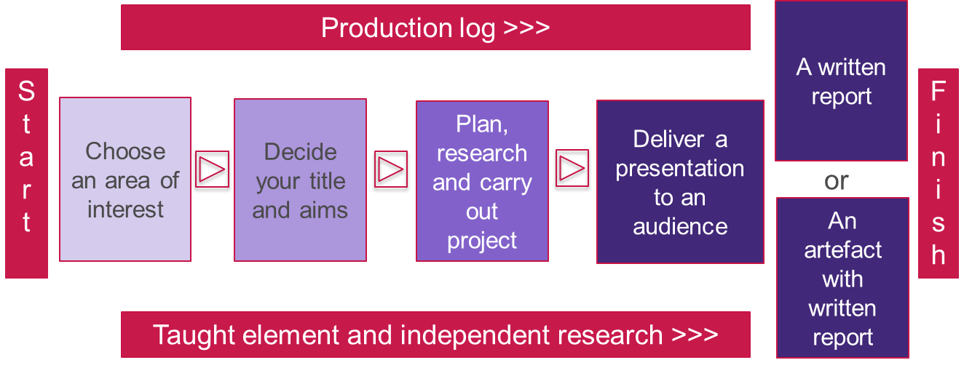
Where their journey starts – what’s in a Project?
Notes:
Students will always begin by choosing an area of interest – the topic they want to investigate.
Once they’ve chosen a broad topic they’ll think about how they can develop their title and the aims and objectives of their project. They decide what they're going to deliver in terms of the outcomes for their project and carry out the project to meet the aims.
They will plan, research and carry out their project and deliver a presentation to an audience to tell them all about what has been learned and the outcomes of their research
The presentation can take a variety of forms:
Lecture or seminar
Market place – each student has a stand and presents multiple times to a number of small groups
Online
Feedback from teachers has been the flexible approach to the presentation really support students, particularly those with SEN (use example of mute student and student with anxiety) – the focus of the presentation is to present the project journey and findings and defend their research.
The project progress is recorded in the production log throughout the project journey
All of the project work is supported by a taught skills programme which helps student to develop the skills they need along the way to be successful in EPQ.
Finally, they will deliver the outcome of their project – either an academic written report of around 5000 words of an artefact with an accompanying written report.

Slide 9
Logging progress and achievements
The production log is an ongoing record of the project’s progress
The production log records:
the initial ideas, project proposal recommendation and approval
meetings between supervisor and student
project planning, progress and decision making
development of your students’ projects from the initial ideas to summary and refection
the live presentation and Q and A
supervisor marking.
Notes:
The whole process is supported by the Production log, in which students record their initial ideas, their project proposal, planning, and decision making as well as meetings with their supervisor – the prompts in the log support students to think deeply about their project journey and support rich, student led, conversations with their supervisors
Project Q provides an interactive, electronic version of this.

Slide 10
The project product (EPQ)
\
\
\
^{5,000 words}
^{a formal academic report}
^{research based}
^{fully referenced.}
Minimum 1,000 word report and created product, for example:
an engineered piece of work; a robot or a model aeroplane etc
a play that’s been written, produced, or directed
an original musical composition
a computer programme or website.
^{Got a shared vision?} Students can work in a group and create together, developing their individual EPQ along the way.
^{Written report}
^{Artefact with written report}
^{Group projects}
Notes:
Students make a choice of whether they’re going to present the outcomes of their research in one of two ways.
They could either present the outcomes of their research in a 5,000 word written report (2000 words for HPQ)
Or they could present the outcomes of their research in what we call an artefact.
An artefact is something the student would like to create for a purpose – it can be a physical outcome such as a book or a short film, or it can be a presentation to a specific audience – like a play, or an event such as a fashion show, or a musical evening. It might be an experiment, a performance, a website, a vehicle or a garment. There’s almost no limit to what constitutes a project artefact, as long as it has research at its core. So, we do encourage students, and we encourage supervisors who are supporting students, to come up with their initial project ideas, do their initial project research, and then that should drive them as to what the outcome looks like. Is it better, as a written report, or is it better as an artefact?
The key thing with the artefact is, it's got to be grounded in that research.
There is also the option to embark on a project within a group – although they’re not as common as written reports and artefacts we’ve seen some successful group projects which have really helped students to grow as individuals and become more confident working within others

Slide 11
Discovering true passions
\
\
\
\
\
^{To research,} plan and produce (own needlework) an eighteenth century ball gown.
^{Can true} ^{happiness} ^{be found in a} ^{single moment?}
^{To what} ^{extent do genetic} factors contribute to a propensity towards addiction in humans?
^{How dimples} ^{affect the aerodynamic} ^{drag of a} ^{golf ball.}
^{Should you} be concerned about mass surveillance?
\
\
\
\
\
^{Could} hydro-electric power be created outside our ^{front door?}
^{How sustainable} ^{is the financial inequality} ^{between teams} ^{in the English Premier League?}
^{How can we} ^{help those suffering} ^{from elderly loneliness?}
Can emergency whistles be optimised for design and ^{use in rural environments?}
^{Construction} and testing of a small-scale hybrid rocket motor.
Notes:
Examples of past projects
The beauty of projects is that they really encourage students to explore what matters to them.
Feedback we’ve received from one student is that the EPQ appealed to them because they had the freedom to research a topic they really cared about.
Some students may choose a project that perhaps supports their interest in what they'd like to study at university. They might extend their learning beyond their A-level subjects. And some may do something completely different
An artefact we saw a few years back was investigating the benefits of singing through creating a community choir.
The work the student did in actually developing their own community choir, could have been delivered in a 5,000 word written report, they could have showed the outcomes there. In fact, what they chose to do was, have the community choir as the artefact. So, for this student, they wrote a shorter written report detailing their research, which they always need to do, but the actual outcome of the project was the community choir they set up.
Feedback from teachers on what they see in the classroom is the student developing some really wonderful skills in terms of growing as a human being and growing as a young adult

Slide 12
Benefits of Projects Qualifications

Slide 13
Why are Project Qualifications important?
Develop a broader range of skills
Lead to better study and work outcomes
Relieve the pressure of high stakes exams
Broaden their curriculum and deepen their knowledge
Nurture their passions

Slide 14
Smooth progression through Project Qualifications
FPQ, HPQ and EPQ project process and taught skills approach are the same
30 hours taught skills
30 hours independent work for FPQ and HPQ, 90 hours for EPQ
Learners can follow the same model of taught skills
Transition from extended to higher, higher to foundation and vice versa depending on progress and attainment

Slide 15
Bridging to the next stage with HPQ
The Level 2 Higher Project Qualification is a great choice for level 2 programmes in colleges
The skills developed support transition to the next stage of education or work.
HPQ as part of a level 2 programme builds skills, motivation and confidence and bridges the gap to level 3 study.
We see HPQ used to explore:
future careers
personal passions
future courses and topics
level 3 courses.
Notes:
Projects can also support transition through the school and from GCSE to A-level
When students start at sixth form, they are usually expected to undertake independent study outside of lessons to support and deepen their subject knowledge – for many, this is the first time they will have been asked to do this and it can be a real struggle to adapt.
L1/2 projects are a great way to introduce student led, independent learning and provide students with a freedom of exploration and to be rewarded at the same time.

Slide 16
Bridging to the next stage with EPQ
The EPQ is a desirable choice for university It’s a skills bridge to higher education study.
The skills developed support transition to undergraduate courses:
Providing evidence of essential research and academic skills
Equipping young people with resilience, self-starting and autonomous working practices
Being considered by tutors as part of alternative offers ‘we’ll allow a drop in academic grade because you're bringing EPQ skills with you...’
Universities are researching the impact of EPQ on progress and performance in undergraduate courses
Notes:
We get so many anecdotes from students we meet when we visit universities about how when they got to uni they realised the value of their EPQ in equipping them for university academic, study and life. We also hear from students it was their EPQ that helped them to discover what they wanted to study at university.
Projects aids the development of cultural capital and helps support students in interviews, especially for the more competitive universities.
The EPQ is really useful in preparing students for higher education study - not just because of the research, planning and organisation skills they’ve developed but also their ability to self start, think critically and face set backs.

Slide 17
What EPQ can do for your students’ academic success
Increase chance of achieving A-level A* – B by up to 29%
Worth half an A-level in terms of UCAS points
Learn how to work independently on their own topic
Receive lower offers from some universities
Discuss in university interviews
Learn how to research and reference
Notes:
Many universities make lower A-level offers to students with an EPQ – and it gives students the chance to show their interest in and passion for a topic or area of study that can give them something to discuss and show their commitment to in admissions and employment interviews.
Research conducted by the University of Southampton indicates that students may be less likely to leave university after their first year if they’ve taken EPQ in sixth form.
They think this is because the EPQ better prepares students to progress to university
The EPQ mirrors the expectation from a university that students will plan, time manage and develop their own work independently.
It teaches student skills such as research methodology and academic writing as well as how to reflect on their progress and make adaptations.

Slide 18
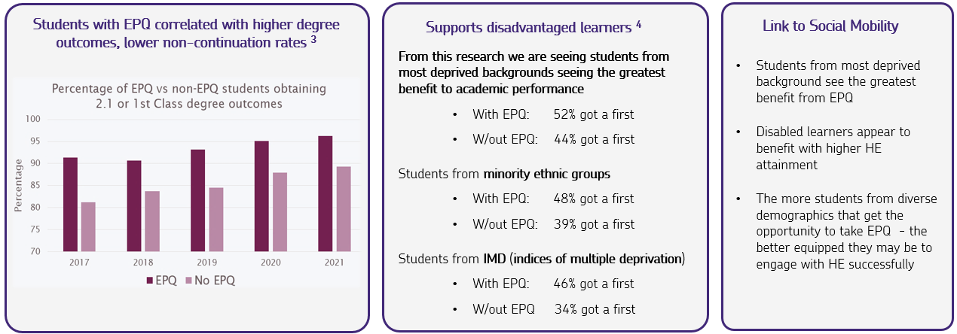
EPQ, social mobility and higher future attainment
Research presented by the Universities of Southampton and Leeds draws a strong connection between students completing the EPQ and social mobility as well as higher future attainment in HE ^{1, 2}
Thompson, Dr E and Harrison Moore, Professor A, 2022, Social Mobility at the EPQ Conference Held at the University of Southampton on 20 October 2022. Keynote was given by Professor Abigail Harrison Moore from University of Leeds and Professor E Thompson from University of Southampton. 2. Please note additional research is needed to understand more about what underpins the descriptive statistics emerging in the research 3. Research from University of Southampton 4. Research from University of Leeds
Notes:
The research also indicates that students may be more likely to obtain a better class degree if they’ve taken an EPQ (more likely to obtain a 1st or 2:1)
Again, they think this may be because students who take an EPQ have had a head start in developing the required skills to be successful in undergraduate courses.
New research from University of Southampton and University of Leeds draws a link between EPQ and social mobility and future higher education attainment.
From this research we are seeing students from most deprived backgrounds seeing the greatest benefit to academic performance for example,
Of those from deprived backgrounds with EPQ: 52% got a first
Those W/out EPQ: 44% got a first

Slide 19
How projects can help your students in the workplace
Gain CV worthy skills
Learn how to interview
Improve their planning skills
Learn how to reflect on work and suggest improvements
Improve their time management
Build their abilities in conducting research

Slide 20
Benefits of offering Project Qualifications
Allows learners to follow their passions and stand out from the crowd
Allows learners to follow the curriculum independently
It can fit into the existing curriculum model
The Taught Skills programme benefits all students – and projects allow for application of those skills
Deadlines can be flexible
Easy access to a range of online learning resources
University advocacy and alternative offers
The skills developed can enhance performance in other subjects and to the next stage in life

Slide 21
Tips for a successful EPQ programme

Slide 22
Great project programmes
The following are features we see in great project programmes
SLT champions
Embedded in the curriculum and on the timetable
Upfront information on EPQ to students, parents and staff
Rigorous proposal approval process
Well managed and supported supervision

Slide 23
Great project programmes (cont...)
Invest in the supervisor as a key role
Training
Standardisation and marking
Moderation
Review
Encourage students to stay focused
Careful sequencing of topics and activities
Clear ambitious school based deadlines
Consider tools such as Project Q

Slide 24
Assessing the Potential of a Proposal
The supervisor assesses the potential project against the following checklist.
1. Does the working title of the project and proposed action allow the student to investigate and to access the higher-level concepts and skills in the assessment objectives, i.e. plan, research, analyse, evaluate and explain, rather than simply describe and narrate?
2. Are the working title and proposed action clear and focused on an issue which can be managed within the timescale, available resources and word total?
3. Does the working title and proposed action indicate that the student will be capable of investigating and researching the topic or carrying out the activity or task independently, safely and ethically?
4. Is there a danger that the student will be unable to approach the project impartially and in a balanced way?
5. Is the student likely to face difficulties understanding the concepts associated with the project topic?
Notes:
The checklist for ‘assessing the potential of a proposal is taken from the EPQ Specification. The Record of Initial Ideas is a crucial starting point for discussion with the candidate around the formulation of an idea and then the question. The Supervisor should not be overly directing the candidate, but should be facilitating discussion which then enables the candidate to hone their ideas ready for the Project Proposal A. Explain that at proposal stage students are not expected to have a final, well-crafted title. Though a good understanding of what makes for a good title is important. The working title will be written in the student’s Proposal Part A. The final title will not be written until the Mid-project Review.

Slide 25
Dual Accreditation
An EPQ project should go beyond a student’s programme of study and not be closely linked in nature or content to other studies (including those which may not have yet been taught yet).
The Project Proposal Part B is key for supervisors to make clear that there are no concerns over dual accreditation.

Slide 26
Approving Artefacts
When formulating titles, supervisors should encourage students to develop a proposal that incorporates how they will measure the success of their artefact after they have created it. There needs to be a purpose to the artefact proposal.
Artefacts need to identify a clear purpose/audience/user, and planning for an objective check/evaluation by the intended audience and/or expert.
Artefact projects must be primarily research projects. Research should come first and the product second.

Slide 27
Artefacts Vs 5000 word product
Students can either submit a research-based written report as their product which is 5000 words or they can opt to produce an artefact with an accompanying shorter research based written report.
If students choose an research-based written report as a product, they should aim to write 5000 words. There is no 10% margin either way – the aim is 5000 words.
If students choose to produce an artefact then an academic report accompanying the artefact is required. The report should be a minimum of 1000 words.

Slide 28
Artefacts
The key aim of artefact projects is to produce a fully functioning, fit-for purpose artefact. Artefact projects must have clear research aims from the beginning and clearly identified evaluation methods.
Planned research should form the largest part of the project and that the production of the artefact should only start once detailed and wide research is completed; all artefact projects must be research-based and have a clear purpose. The artefact should not be produced prior to the research being carried out.
The report that accompanies the artefact should not be a ‘write-up’ of what they have done but, rather, should demonstrate a synthesis of the research and how the research has influenced every single design decision that underpins the final product. It is an academic report which is referenced.
Artefacts produced should be of a high standard and consistent with the plan they set out in their Production Log.

Slide 29
5000 word product
Where students have opted for a 5000 word product this should be in a formal academic style which is referenced and contains a bibliography.
Where students have either gone significantly over or under the word limit then this will impact upon the AO3 mark.
Should not be template driven where all candidates from the Centre have followed a similar approach.

Slide 30
Resources
NEA Adviser
Centre Services materials – past training and standardisation materials
Examiner reports
Guides to delivering the Project Qualifications
Welcome pack and student recruitment pack
Curriculum team support

Slide 31
Training and networking
Free online standardisation meetings
Coordinator and supervisor training courses
Virtual community events
Network meetings
In-school events
Six on-demand e-Learning modules:
How to use the production log
What’s expected of the centre coordinator
Understanding artefact projects
What is required to deliver the Extended Project Qualification
What makes a good supervisor
Understanding and applying the assessment objectives and criteria
Notes:
All of our past Virtual Communities and Training events materials are available on centre services, including:
What makes a good EPQ title
Implementing EPQ successfully
Guidance on ethics and safeguarding
Unlocking the potential of artefacts
Marking the extended project
All past teacher standardisation training including projects with examiner commentary

Slide 32
How can Project Q support you in delivering projects?

Slide 33
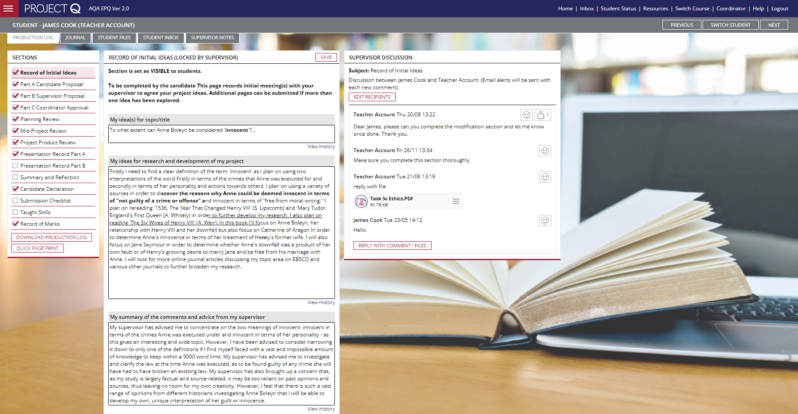
Project Q
Project Q provides tailored workflow tools that simplify the administration of Project Qualifications
Notes:
Project Q is unique – the only complete student management system available, and it makes delivering Project qualifications easy. It saves time, cuts down on admin and gives you more oversight, structure and control in managing students and their work.
The platform is simple and intuitive to use because it is specifically designed for Projects qualifications.
It is a central system that replaces the use of a paper production log and communication by email – the whole project is managed online in one place.
Having the entire project process online provides full transparency for supervisors which can be helpful for monitoring progress, authenticating work and getting a full picture of a student’s project journey.
It also means there is no risk of the important production log being lost or students not submitting work to supervisors, because it is all there, in real time.
Most sections have a ‘view history’ link which open a window to display periodic changes to help snapshot how the production log has developed and changed over time
A discussion area is built directly into the production log area – this helps to support a dialogue between supervisor and student relating to the current section. Files can be uploaded and shared and email notifications are sent to recipients when comments are saved
Supervisors can send messages to all students at once

Slide 34
Features and benefits of Project Q
Delivers real-time interaction of students' EPQ progress
Compiles the information required for submission of students' assessment evidence
Reflects the production log and supervisors can lock sections when complete, removing the risk of retrospective completion of the log
Course resource section is a place for coordinators and supervisors to share files and resources, useful for Taught Skills materials
Features such as a journal and files area can be useful to students to demonstrate the development of their project – this will also be useful when completing reflections
It can help raise engagement, retention and achievement
Notes:
Supervisors can view the status of each learner; when they last logged in, the section entries they’ve made – useful for helping students to stay on track
Some sections such as record of mark can be locked from the students view.
The journal feature provides a place for students to record notes, research and progress
Project Q will save automatically and students can also save automatically
At the end, the sections are all exported into the official Production Log format
You can view a full cohort status report at a glance
To really get the most out of the platform – all Projects activities should take place within Project Q. Think of it as a ‘one stop shop’. It will require some time for initial set up, e.g. transferring Taught Skills resources from your school system to the Resources area of PQ and setting up the courses - but once this is done, it’s done and each year you will just need to update cohorts/supervisors – add any additional resources etc.

Slide 35
Project Q
Project Q is available now (free of charge) for AQA centres
You can sign up/renew on the Project Q website – www.projectq.co
Once your account has been created, you’ll receive a welcome email with guidance on how to get started.

Slide 36
Any questions?

Slide 37
Get in touch
Tel: 0161 957 3980
Email: projects@aqa.org.uk
Twitter: @AQA
aqa.org.uk

