Slide 1
Transition to Higher Education
Daniel Winwood – Skills Development Manager

Slide 2
My Role and Experience
Funded by the University’s Access and Participation Plan
Embedded in the Skills Centre
Provide transition support to students entering the University
Previously worked with international students teaching on and co-ordinating Pre-sessional, International Foundation and International Year One courses at Into University of Gloucestershire and UWE Bristol’s International College

Slide 3
Supporting Transition
Transition is ‘the capability to navigate change’
Three views of transition
Type 1: Induction
Type 2: Development
Type 3: Becoming
(Gale & Parker, 2014)

Slide 4
Supporting Transition
Linear journeys
A process to be smoothed
Occurs at identifiable stages
Homogenous
A gap in knowledge
Non-linear and fluid experiences
Troublesome and individual becomings
Ongoing
Diverse
Students have experiences to be celebrated, and are individuals
(Gravett, 2021)

Slide 5
Transition at Bath
Activities, programmes and events
Access to Bath
Transition Toolkit
Induction
Skills Centre
Student Support

Slide 6
The Skills Centre
leads the development of academic, digital and language skills, to better support learner independence
Skills provision
Embedded skills support
Extra-curricular skills support
Online self-access skills support
Language learning
Maths and statistics support
Support for transition to year 2

Slide 7
The Skills Centre
Semester 1:
Skills enrichment classes (discussion / presentation skills)
One-to-one writing tutorials
One-to-one exam skills tutorials
Mathematics Resources Centre (MASH) drop-ins
MASH workshops
Statistics Advisory Service (SAS)
Eight foreign language courses
Peer Assisted Learning (PAL) language sessions

Slide 8
Access to Bath
A self-access course for UK based undergraduate offer holders who meet our widening participation (WP) criteria
Provides WP offer holders with a better understanding of study and life at the University of Bath
Helps WP offer holders develop confidence around transition to Higher Education
Encourages WP offer holders to choose the University of Bath as their place of study through the one-grade drop in the standard A level offer

Slide 9
Access to Bath
Eligibility criteria:
POLAR 4, quintiles 1 - 3
Indices of Multiple Deprivation, quintiles 1 - 3
Care leavers
Young carers
Refugee, asylum seeker or people who have been granted humanitarian protection
Key numbers:
2021 | 2022
732 registered 483 passed 325 progressed to Bath | 820 registered 587 passed 395 progressed to Bath

Slide 10
Access to Bath
Subjects covered:
Getting ready to go to university
Arriving at university
Welcome and Freshers’ Week
Starting your course
Academic skills at university
Other key skills at university

Slide 13
 | Pre-course questionnaire | Post-course questionnaire
Feeling like you will belong at Bath | 3.79 | 4.15
Finding other people ‘like me’ at Bath | 3.49 | 4.05
Developing friendship groups | 3.56 | 3.96
Having the academic potential to succeed | 4.08 | 4.26
Having the academic skills to succeed | 3.91 | 4.12

Slide 14
 | Pre-course questionnaire | Post-course questionnaire
Activities available outside learning (e.g. clubs, societies) on offer at Bath | 2.75 | 4.37
How to do an academic piece of work | 2.91 | 3.97
Where to go for help if I need it | 2.44 | 4.51
Peer support | 2.50 | 3.98
What it is to be a university student | 3.00 | 4.32
How learning is different at university from school/college | 3.18 | 4.58
How much of an independent learner I am expected to be at university | 3.69 | 4.59

Slide 15
The Transition Toolkit
Collates resources available across the University’s webpages to develop offer holder knowledge and confidence prior to starting university
Content informed by Access to Bath feedback, WP focus groups and WP student ambassador input
Incorporates student voice through blogs and videos
Includes an accompanying diagnostic tool
Split into four sections:
Preparing to study at Bath
Preparing to live at Bath
What our students say
Next steps

Slide 19
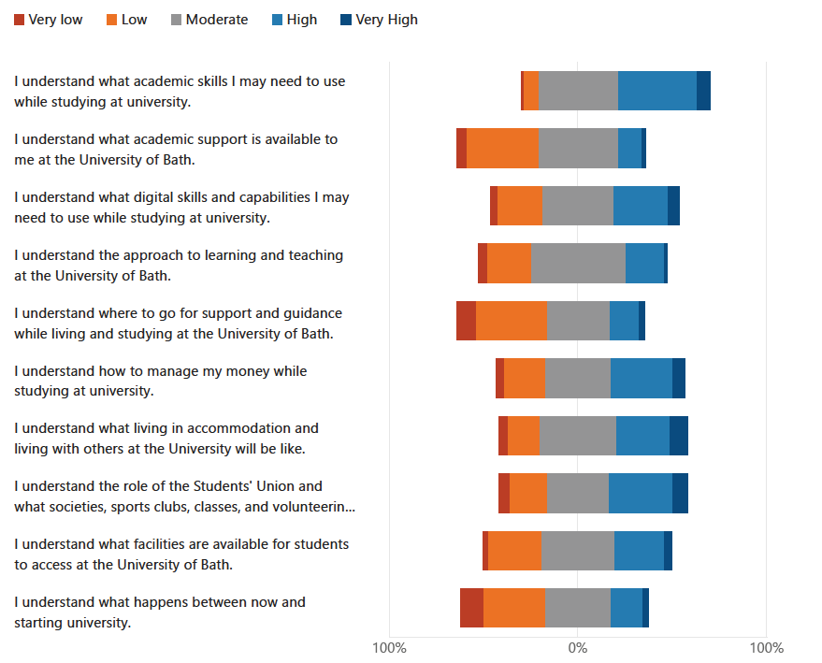

Slide 20
Transition Resources
The Transition Toolkit
Access to Bath
Outreach Resource Hub
University of Bath Student Bloggers

Slide 21
Transition Resources
Pearson: Wellbeing Toolkit
The Open University: Study Skills
University of Bristol: Upgrade to Bristol
Queen’s University Belfast: Transition Skills
Student Minds: Transition into University
Stella Cottrell: The Study Skills Handbook

Slide 22
References
Gale, T. and Parker, S., 2014. Navigating change: a typology of student transition in higher education. Studies in Higher Education, 39(5), pp. 734-753.
Gravett, K., 2021. Troubling transitions and celebrating becomings: from pathway to rhizome. Studies in Higher Education, 46(8), pp. 1506-1517.

