Slide 1


Career Conversations
This presentation has audio commentary, which you will hear each time you advance the slide
Notes:
A career conversation is a regular, discussion that helps a member of staff work out what they would like to achieve in their career, to understand how they are doing at the moment, and to make plans to move towards their goals.
We’re introducing it to take the place of the annual Staff Development and Performance Review for staff in the Education and Research Job Family, but it could be part of a mentoring or coaching process, as it shares the same intention to help people understand their strengths and potential, and take responsibility for managing their career.

Slide 2

What is a “career conversation?”
A conversation, conducted with purpose, which allows you to reflect and focus on your career, your successes, strengths and potential. It should build on these to set goals and make commitments for the future
Notes:
What’s distinctive about a career conversation? It is a regular, purposeful discussion that helps a member of staff work out what they would like to achieve in their career, to understand how they are doing at the moment, and to make plans to move towards their goals.

Slide 3

X
What is a “career conversation?”
Notes:
It’s not an exercise in filling in a forms and ticking boxes.

Slide 4
What should I get from my career conversation?

Slide 5
What should I get from my career conversation?
A clear, evidence-based and self-aware sense of where you are now, how you are doing with respect to:
  Your own motivation and aspirations
  The expectations of someone in your role
  The context in your life, the department, discipline, University and beyond.
Clear goals that will help you find fulfilment at work and achieve your potential.
An individualised view of your career path and how you will respond to opportunities.
Notes:
It’s the job of the reviewer, mentor or coach to help the individual think rigorously about how they’re doing, where they want to go and how they can get there.

Slide 6
A change of mindset
Traditional performance review
I’m going to tell you how you are performing and I will set you objectives. Your performance will be measured against these objectives next year
Notes:
To have a successful career conversation, you need a particular mindset. In a traditional performance review, the reviewer passes judgement on a person’s performance, usually related to the achievement of objectives set some time ago. In some organisations, that’s linked to pay and promotion, which limits the value of the conversation and skews behaviours.

Slide 7
A change of mindset
Career (coaching) conversation
I’m going to help you discover your own strengths and values, and work with you to design a path to achieving success, whatever that means for you in your context
Notes:
A career conversation, by contrast, is a process in which an individual is helped to tap into their own values and aspirations and set meaningful goals in their own context. The focus is shifted from the voice of organisational management to the intrinsic motivations of the staff member and how they can be best satisfied within the context of the organisation, and the work it needs to do. It’s important to consider how well people progressed against their goals, but with the focus celebrating, earning and looking forward, rather than assessing what’s gone before.

Slide 8
More appropriate in highly specialised professional roles, where people tend to have a large degree of autonomy and are strongly motivated to pursue their own career interests.
If you’re successful, we’re successful
Notes:
Many organisations have found that this works better, especially for people in highly specialised professional roles with a large degree of autonomy and stong personal motivations. The organisation, in this case the University, recognises that if you’re successful, we’re successful, so the aim is to set up a system that helps you to thrive. Having regular, supportive review and reflection conversations is a highly beneficial and necessary part of this.

Slide 9
Four domains in a career conversation
Values and aspirations
Goals and plans
Context
Self-awareness
Notes:
So what happens in a career conversation? We use a model that has four domains. Let’s look at each of them.

Slide 10
What really matters to you?
Values and aspirations
Goals and plans
Context
Self-awareness
Notes:
Values & Aspirations. What matters to you?
It’s in here you may talk about why someone is driven to be an academic in the first place? What do they get out of it? Where do they see their career going? Do they want to be a professor by age 40, are they spending a few years with starting a family, is there a specific change they’re trying to produce, through their research or teaching? What are they not doing now, that they would like to?

Slide 11
Values and aspirations
Goals and plans
Context
How are things going for you?
How do you know?
Self-awareness
Notes:
How are things going? This is where you may talk about what went well in the last year, the extent to which you’re achieving your ambitions or succeeding in projects, informed by things like research outputs, successfully delivered taught programmes, thriving partnerships and opportunities opening up. You could also think about how all those things relate to the academic career structure: are you preparing for a promotion bid, and how do you look against those things that will be assessed? Or Is promotion not a relevant thing at the moment?

Slide 12
Values and aspirations
Goals and plans
Context
What’s going on?
(with...)
Self-awareness
Notes:
What’s the context we find ourselves in? What’s happening in the world around us, in the University, the Department. Home and family? What’s hot in the discipline? Everyone’s circumstances are different, and everyone needs to balance personal aspirations with what the Department requires and what they’re going to get fulfilment from.

Slide 13
What are you going to do now?
Values and aspirations
Goals and plans
Context
Self-awareness
Notes:
It’s helpful to have goals, and to make and commit to plans. This is an opportunity to put some disciplined thinking into what you’re going to do next, to move towards those aspirations. What are the first practical steps, what support do you need to seek out?

Slide 14
What are you going to do now?
What really matters to you?
Start anywhere
Values and aspirations
Goals and plans
Context
How are things going for you?
How do you know?
What’s going on?
(with...)
Self-awareness
Notes:
The conversation can start anywhere in these domains: it’s sometimes helpful to open up with just: “how are things going?” and see what happens. By the end, you should have covered all these areas and focused down onto a few key goals, with plans of how to get there.

Slide 15
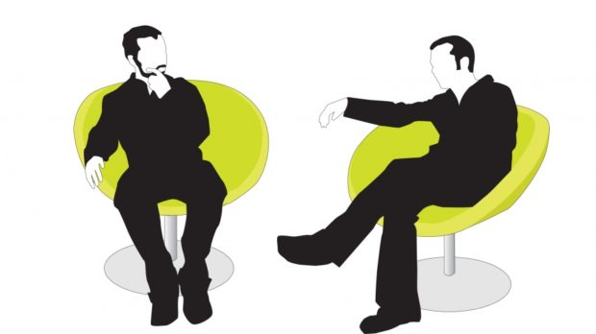
Reviewer’s role and skills
Notes:
Let’s think about the skills the reviewer or mentor will need to conduct a successful career conversation. Establishing rapport and trust is obviously important, we want people to feel safe exploring their career goals and potential.

Slide 16
It works when…
It is a purposeful conversation – not just a comfortable chat -
that prompts discovery and growth
and the subject takes responsibility for acting
The Reviewer’s Role
Assist them to discover their own strengths and values
Work with them to design their path
Ask challenging questions: encourage them to reflect on their actions, decisions and behaviours
Notes:
These are not merely feel-good conversations, but neither are they just a form-filling exercise. The conversation, awareness and commitments made are what count.
Reviewers need to listen carefully and ask the questions that help people go deeper into their understanding of themselves and their situation, potential and options.
Ultimately the “reviewee” has to take responsibility to act, guided carefully by what they’ve learned about themselves.

Slide 17
The many roles of the reviewer
A mentor brings their own experience and expertise to bear in supporting others’ growth and development; they have walked the path before.
Who am I?
All of these.
Mentor
Leader
Peer
Coach
A coach does not need any specialist knowledge of the person’s professional discipline, but is skilled in using questions and challenge to draw out their understanding and goals, and so to help them make plans and commit to action.
As a senior colleague, you have a responsibility to make sure the individual understands the needs of the discipline and organisation.
The conversation is a respectful one between colleagues who are mutually supportive and have a common interest.
Notes:
Mostly people have conversations with someone who is not their line manager, so you may ask what role the reviewer has. They may be fulfilling any or, more likely all, of these roles: bring the experience of the mentor, using the skills of the coach, holding the responsibility of a senior but mutually supportive colleague.

Slide 18
In summary: a few features to remember
This is about the whole person, what’s important and what gets you motivated
It’s supportive and informal but still has the rigour of self-awareness, evidence and deliberate goal setting
This is still about work, so goal setting should be aligned with organisational needs

Slide 19
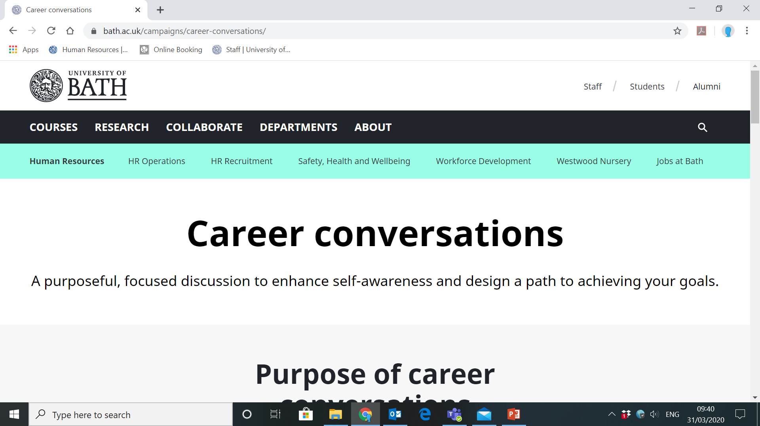
Notes:
You can find guidance and documents for Career Conversations on the University website. Type “Career conversations” into the search box.

Slide 20
Notes:
You can find documents including the record form, which has reminders about the structure and process.

Slide 21
Notes:
There are text boxes to record the essential reflections, goals and plans.

Slide 22
Notes:
You will also see some possible questions that can be used as prompts to move the conversation on in the different domains. Don’t just work through these; look out for the moment that one would be useful.

Slide 23
Some words from our users
“The Careers Conversations helped in putting them into a mindset thinking beyond their … objectives about their mid to long-term career objectives but also how their work fits into the strategic objectives of the Department/ Faculty/ University. All in all, this let to some quite surprising conversations including one where the reviewee told me about their great, potentially faculty-wide plans”
Deputy HoD of an early adopter department
Notes:
Finally, here are some comments we’ve had about the Career Conversations approach from people who have used it.

Slide 24
“I have been running some wellbeing focus groups with academics and wanted to let you know that participants have expressed positive feedback about the wellbeing benefits of the career conversation approach:
The feeling it is a quality conversation
That it is a holistic conversation about them as a person, not just about what they do
Feeling listened to
Encouraging reflection on strengths and weaknesses and how to manage those
Helping to prioritise and think about what is really important”
University Staff Wellbeing Manager
Notes:
As well as career management, there are some emerging benefits from having better quality conversations

Slide 25
Career Conversations
Thanks for listening

