Slide 1
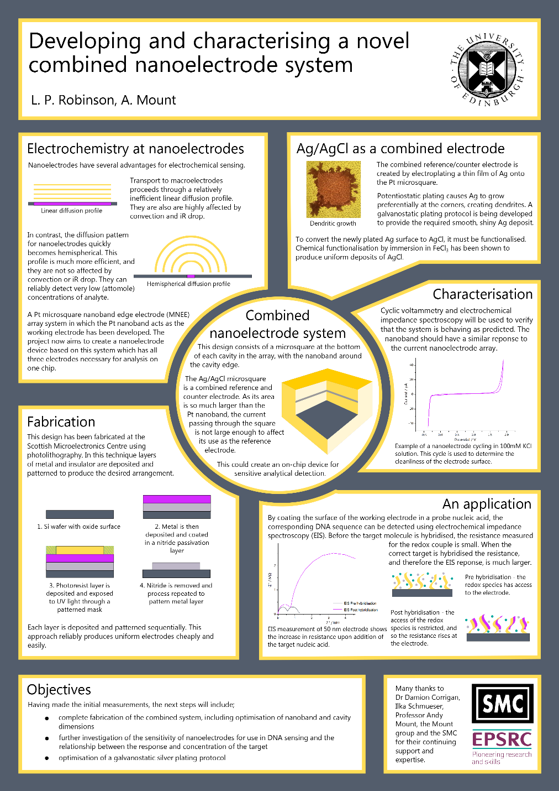
Written communication 2
How to design a good
poster

Slide 2
Written communication 2
Objectives:
To examine why we use scientific posters
To understand the structure of a scientific poster
To analise and judge scientific posters to prepare for your own

Slide 3
Written Communication 2
poster
audience
structure
Visual impact
purpose
In pairs, look at the posters around the room and take notes: What is the purpose and audience? Make a list of things to include (structure) and tips for making it look good.

Slide 4
Written Communication 2
At meetings, there is usually a room for poster presentations – the number of posters is larger than the number of talks → scientific ideas are communicated via posters
Convey ideas quickly and in an eye-catching way
Contain enough detail to spark discussion

Slide 5
Written Communication 2
Usually, your target audience would be other researchers.
In this case, your target audience are your peers, parents, teachers and University staff

Slide 6
Written Communication 2
Title: Large, simple and punchy
Author: You et al.
Affiliation: Department of Biology & Biochemistry, etc.
Summary: Keep this brief. What’s the question, what have you done, and what does it demonstrate?
Introduction and aims: Keep the introduction concise, and make the aims clear. It may help to enumerate them.
Methods: Keep these brief. Some methods may be better presented as a figure, or incorporated into a footnote.
Results: Describe the data concisely, and bring out the key points. Always refer to the relevant tables or figures.
Discussion: This can often be incorporated into the results section.
Conclusions: Consider the use of bullet or numbered points.
Figures and figure legends: Intersperse these with your text, and include at least as many figures as blocks of text (see below). Make sure that the legends are self-explanatory.
References: List only the most important (perhaps up to half a dozen).

Slide 7
Written Communication 2
Don’t use more than two fonts
Make sure the figure legends stand out from the rest of the text.
At least as much space for figures/tables/diagrams as for text
No dead spaces.
Watch out for colours – it should be easy to read

Slide 8
Written Communication 2
poster
audience
structure
Visual impact
purpose
In pairs, look at one of the posters and score it with the mark scheme.

